Slide 1
Vaccination Trend Analysis

Slide 2
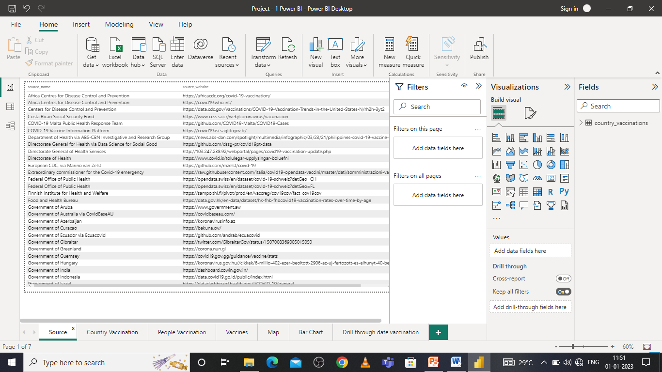
Source

Slide 3
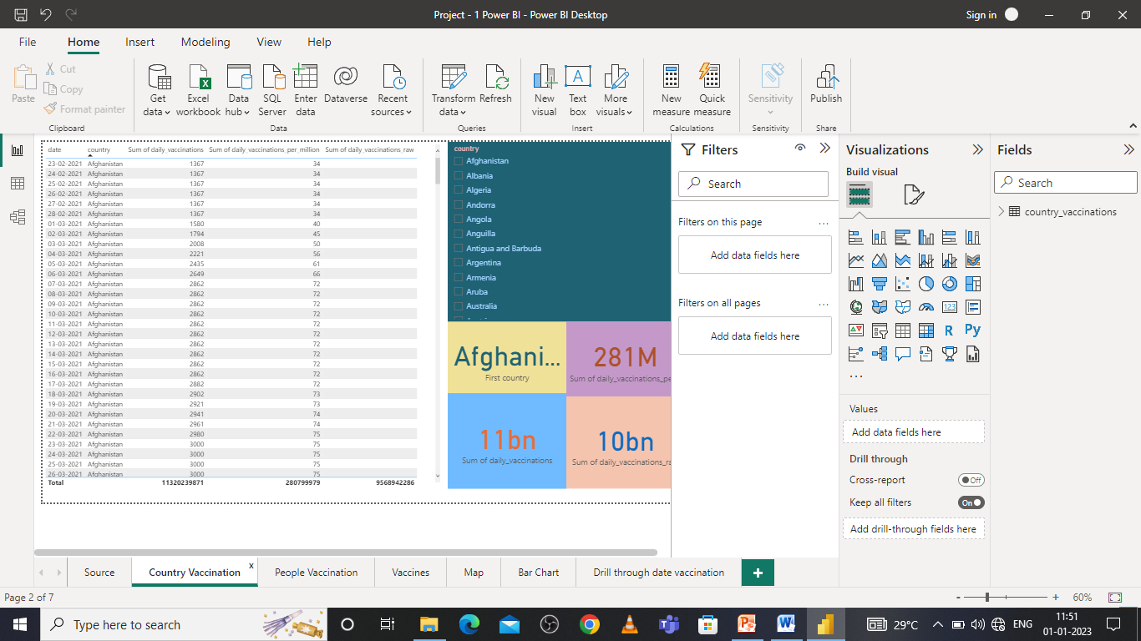
Country Vaccination

Slide 4
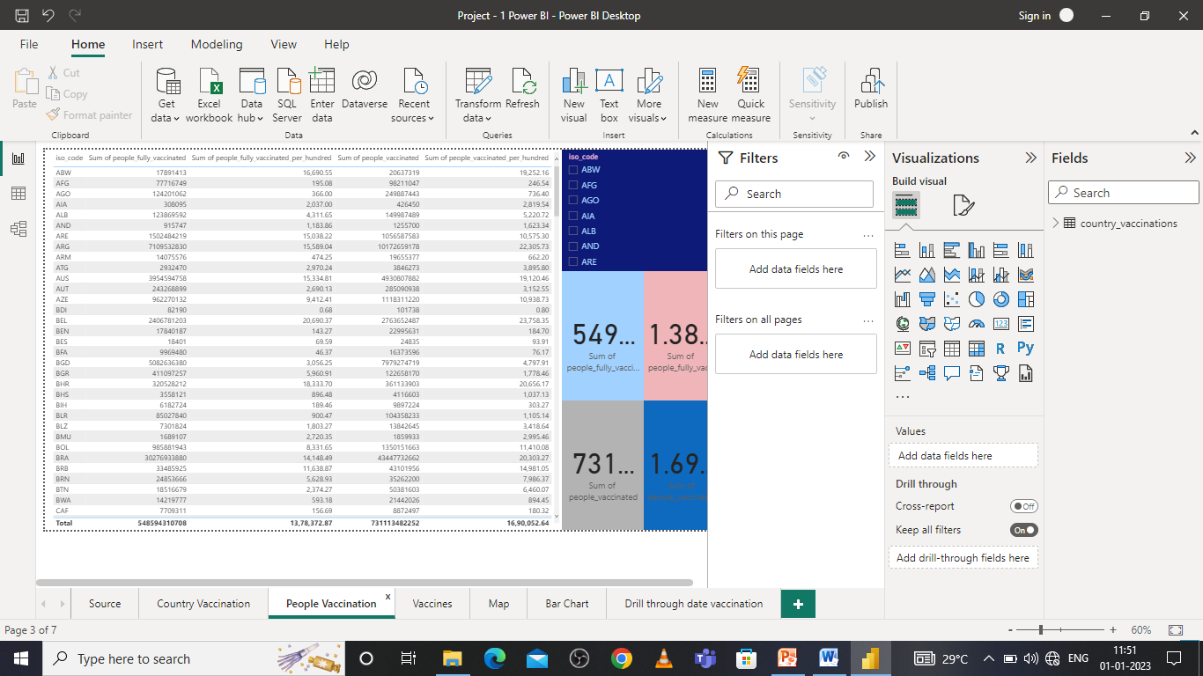
People Vaccination

Slide 5
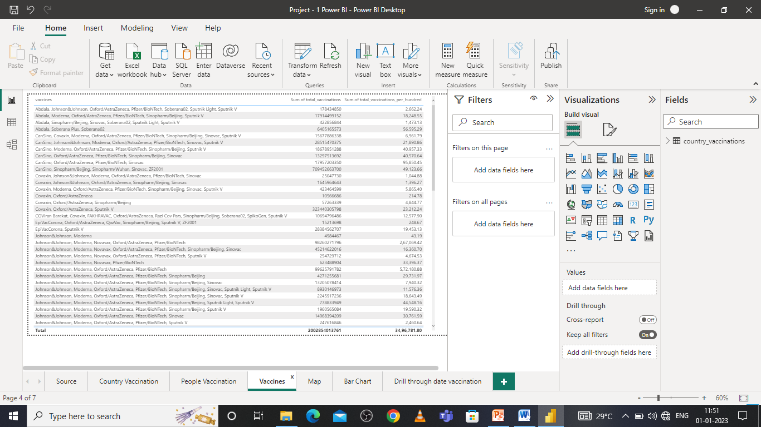
Vaccine Types

Slide 6
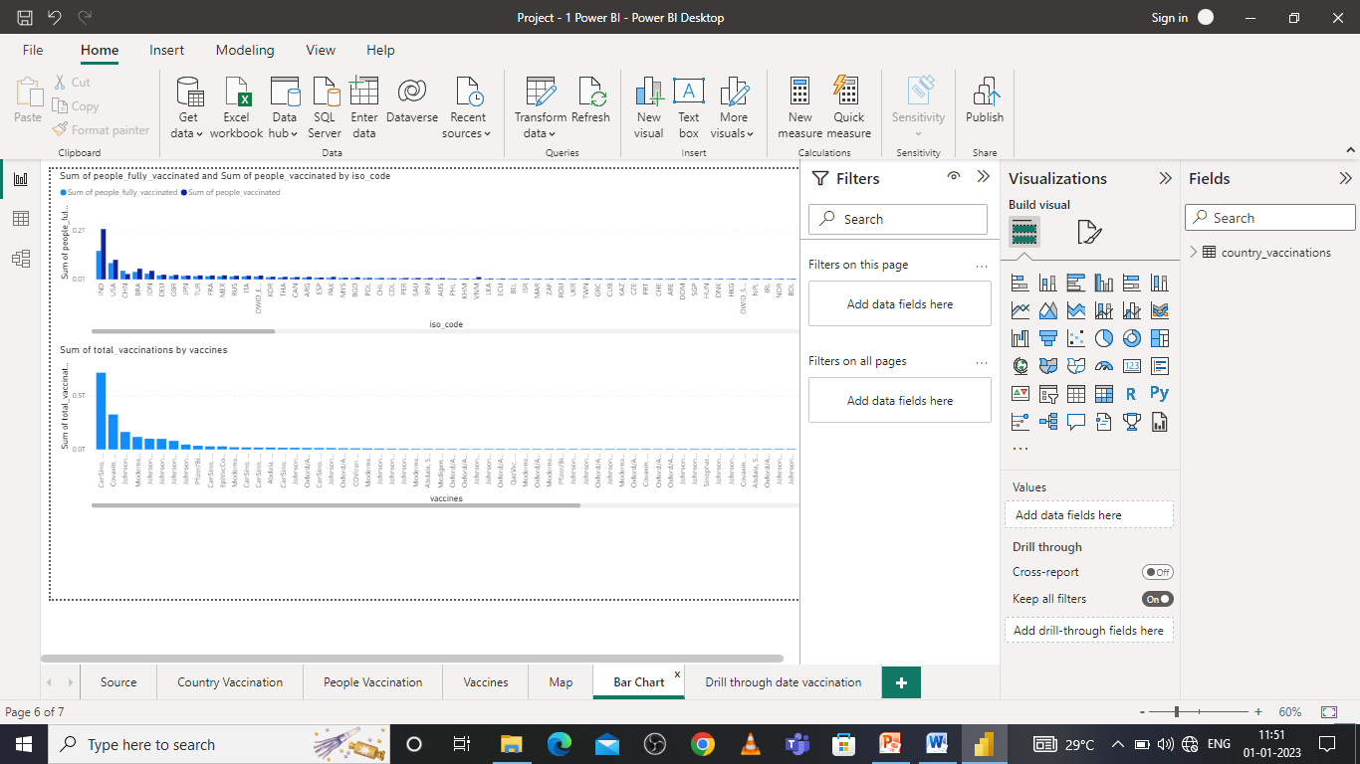
Bar Chart

Slide 7
Thank You

